Slide 1
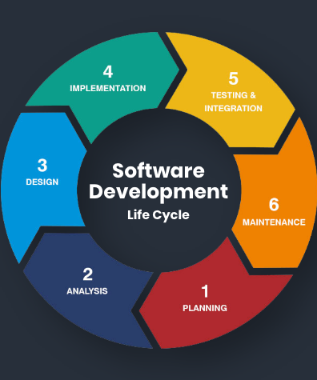
Cache - Key of Performance
Ghergu Nicolae-Marius
Single-Level Cache, Distributed Cache & Performance Testing

Slide 2
CONTENTS
Chapter 1 | What is Cache? Single-Level Cache and Distributed Cache
Chapter 2 | Cache Solutions for Single-Level Cache for Spring Applications - EhCache & Caffeine
Chapter 3 | Microservices and Data-Intensive Applications - Real Problems & Examples
Chapter 4 | How distributed cache can boost your application by 1000% - Intro to Hazelcast
Chapter 5 | Intro to Performance Testing - Gatling
Final | Demo

Slide 3

HOW TO CREATE A PROJECT PROPOSAL
Creating a project proposal can be done in five steps:
Define the project objectives and timeline
Identify resources needed to complete the project
Develop a budget for the project and estimate any potential risks associated with it
Write down your proposed solution and provide supporting documents or evidence that prove its feasibility if necessary
Develop a communication plan to ensure key stakeholders are kept informed of progress throughout the entire process

Slide 4

01
What is Cache?
Single-Level Cache and Distributed Cache

Slide 5


Definitions
Single-Level Cache
Distributed Cache
Refers to a caching mechanism where data is stored and accessed from a single cache instance. In this type of cache, all cached data is stored in a single location, typically within the memory of the application. When data is requested, it is first checked in the cache, and if found, it is return directly.
Is a caching mechanism that spans across multiple nodes and servers in a distributed system. Instead of relying on a single cache instance, the data is partitioned and stored in multiple cache nodes. Benefits? Scalability, High availability, Improved performance and data consistency.

Slide 6
02
Cache Solutions
EhCache and Caffeine for Spring Boot Applications

Slide 7
EhCache
EhCache is a widely used, open-source Java-based cache. It features memory and disk stores, listeners, cache loaders, RESTful and SOAP APIs and other very useful features.
Pro
Widely used, making it a mature and stable caching solution
Offers a comprehensive set of features, including support for distributed caching, caching annotations and cache event listeners
Has good integration with popular frameworks like Spring and Hibernate
Provides support for cache persistence, allowing cached data to be stored on disk or in database for durability.
Cons
Configuration can be complex, especially when dealing with advanced features like distributed caching
In certain scenarios, might introduce some performance overhead

Slide 8
Caffeine
Caffeine is a high-performance caching library for Java.
Pro
Designed to be highly performant, offering fast in-memory caching with low latency and high throughput
Has a simple API, making it easy to use and integrate into applications
Provides various cache eviction strategies, allowing to automatically remove less frequently used or expired items from the cache
Offers flexibility in configuring cache behavior and allows customization of eviction policies, cache loading and cache statistics.
Cons
No built-in support for distributed caching
While offers most of the essential caching features, it may lack some advanced features by Ehcache
Does not have as many built-in integrations with popular frameworks compare

Slide 9
03
Microservices and Data-Intensive Apps
Real Problems and Examples

Slide 10
Microservices and Data-Intensive Apps
Dealing with requests
Traffic
While microservices are sometimes a benefit for applications, other times can be painful.
Why? Because the amount of requests. You need to build a reliable, scalable and maintainable systems.
Traffic means a lot. Actually, the whole thing. Every request can make a lot of traffic and maybe trigger other 20 applications in order to get the final data.
Problems
Problems
Slow response time
High resource utilization
Database performance issues
Suboptimal code and algorithms
Network latency and bottlenecks
A lot of traffic for resources

Slide 11
REAL PROBLEMS
Database DTO & Views
Big Complexity of Code
Let’s say you want to get data from a lot of databases and you increased performance using views. But is that enough?
Let’s say you need to compute a lot of data in order to get the result. For example, a csv and re-build again and again csv, either if you only need another field for that object.
Unavailable services
Memory usage
Let’s say a microservice needs to restart for some seconds. In those seconds, we loss availability.
While we have to compute data, we use memory. For example, some programming languages are well-known for memory usage.

Slide 12
03
Hazelcast
And how to boost your app by 1000% by Distributed Cache

Slide 13
Hazelcast
Open-source, distributed, and highly scalable in-memory data grid platform.
Pro
Offers a robust distributed caching solution, allowing to cache data across multiple nodes in a cluster
Is designed to scale horizontally, allowing to add more nodes to the cluster when application’s load increases
Provides built-in fault-tolerance mechanisms
Offers distributed computing capabilities through its distributed data structures and APIs
Supports publish-subscribe messaging and eventing mechanism
Cons
Provides comprehensive documentation and resources
Comes with inherent complexities, including managing data consistency and network latency
Stores data in-memory and it doesn’t provide built-in support for persistence storage

Slide 14
03
Gatling
Performance testing using Java

Slide 15
Gatling
Open-source load testing tool used for performance testing and stress testing web applications. Provides a range of features and capabilities to simulate high loads and measure the performance of applications.
Pro
Is designed to handle high loads and simulate thousands of concurrent users
Leverages an asynchronous, non-blocking architecture that allows it to generate high level of virtual users without significant resource consumption
Allows to define complex simulation scenarios using domain-specific language (DSL)
Provides real-time metrics and details reports
Integrates well with popular CI tools like Jenkins, Teamcity and Bamboo
Cons
No Built-in browser simulation. It focuses on performance at the protocol level, making it less suitable for testing specific browser-based behaviors or client-side interactions

Slide 16

THANKS!
Do you have any questions?
DEMO TIME!!! https://github.com/nicugnm/single-distributed-testing-presentation

Slide 17
Bibliography
https://www.baeldung.com/cs/
https://www.baeldung.com
https://hazelcast.com/

